Slide 1

Project Report
Manish Kumar
Sai Likhith Narendula
Notes:
Megan note: I need to validate this with OCR side, we may need to call this out as optional for them. I’ll get you more details shortly.
Leor’s comment on Megan’s note:
Agreed - this is a great idea and I'd love to see our OCR interns have the chance to present their work also.
This was not mentioned to our managers before - I believe some groups were already planning something similar (e.g. Oracle Labs under Screven) but others don't. For now, I suggest we strongly recommend it to OCR Managers and Jackie, perhaps we can raise this at the Exec presentations for their additional support?
If any group is unable to provide this showcase opportunity to their intern, we can also host a special demo session and invite the other interns / buddies to watch the presentations.
Thanks,
Leor.

Slide 2
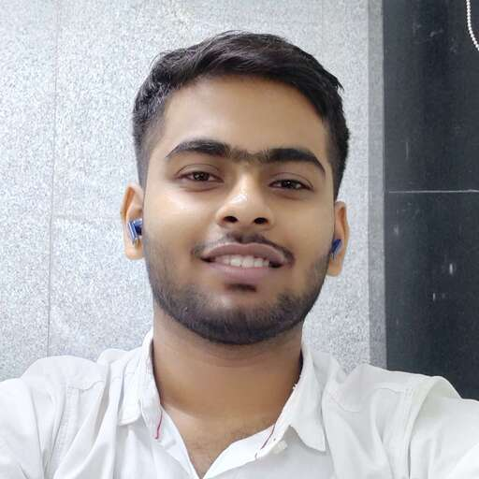
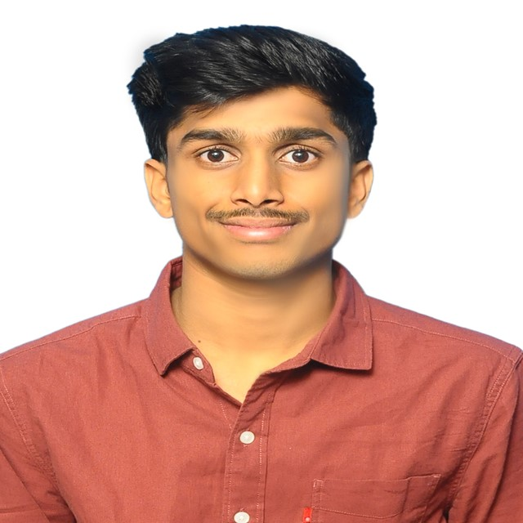
Finance App for Ganesh Finance Limited Company
Manish Kumar
Sai Likhith Narendula

Slide 3




Finance App: Frontend Tech Stack Used
HTML 5
CSS 3 & Bootstrap 5.3
JavaScript

Slide 4
Finance App: Backend Tech Stack
Programming Language: Java 11
Database: Oracle 19c
Database Interaction from application: JDBC
Service Layer: JAX-RS
Server: Apache Tomcat 10.1

Slide 5
Case Study: Current system and its drawbacks
Manual Loan Processing and Document Handling: The company currently relies on manual processing for loan applications and document verification. This has led to problems in document handling, misplacement, and delays in loan approvals.
Document Mismanagement: The company has faced issues with misplacing customer documents, resulting in delays and requests for customers to resubmit their paperwork.
Loss of Business to Competitors: Due to the inefficiencies and delays caused by manual processing and document mismanagement, customers are turning to other finance companies for their loan needs.
Customer Dissatisfaction and Negative Reputation: The combination of manual processing, document mismanagement, and subsequent loan approval delays has led to customer dissatisfaction. This negative experience has likely resulted in a tarnished reputation for Ganesh Finance Limited Company, as customers share their negative experiences and seek alternatives.

Slide 6
Proposal for New system
Automated Loan Application Process: Customers will have the convenience of initiating their loan applications online, eliminating the need for physical visits to the branch. This will significantly expedite the application process and enhance the overall customer experience.
Streamlined Online Loan Application: This portal will allow customers to easily input their personal details, select the type of loan they require, and provide relevant information.
Efficient Document Management: The proposed system will offer a secure document uploading feature directly linked to the company's database. Customers will be able to electronically submit all required documents.
Expedited Loan Approval Workflow: Managers will have access to a streamlined dashboard where they can review applications, assess documents, and make informed approval decisions.

Slide 7
Solution
Our solution assumes three roles a CUSTOMER, CLERK, and MANAGER. Out of these three the CLERK and MANAGER credentials will be added in the Database.
CLERK:
Add new customer and view all Customer details
Add and view Loan Application details
View the details of all types of Loan available at the company
CUSTOMER:
Add and view Loan Application details
Cancel Pending Loan Applications
View the details of all types of Loan available at the company
Use the EMI Calculator

Slide 8
Solution
MANAGER:
View all Loan Application details
Accept or Reject pending Loan Applications
When a CLERK adds a new customer and Email is sent to the Customer with the Customer ID, Username and Password.
Reset Password
On adding a new Loan Application an Email is sent to the Customer
When a MANAGER approves or rejects a Loan Application an Email is sent to the Customer updating him/her about the status.

Slide 9
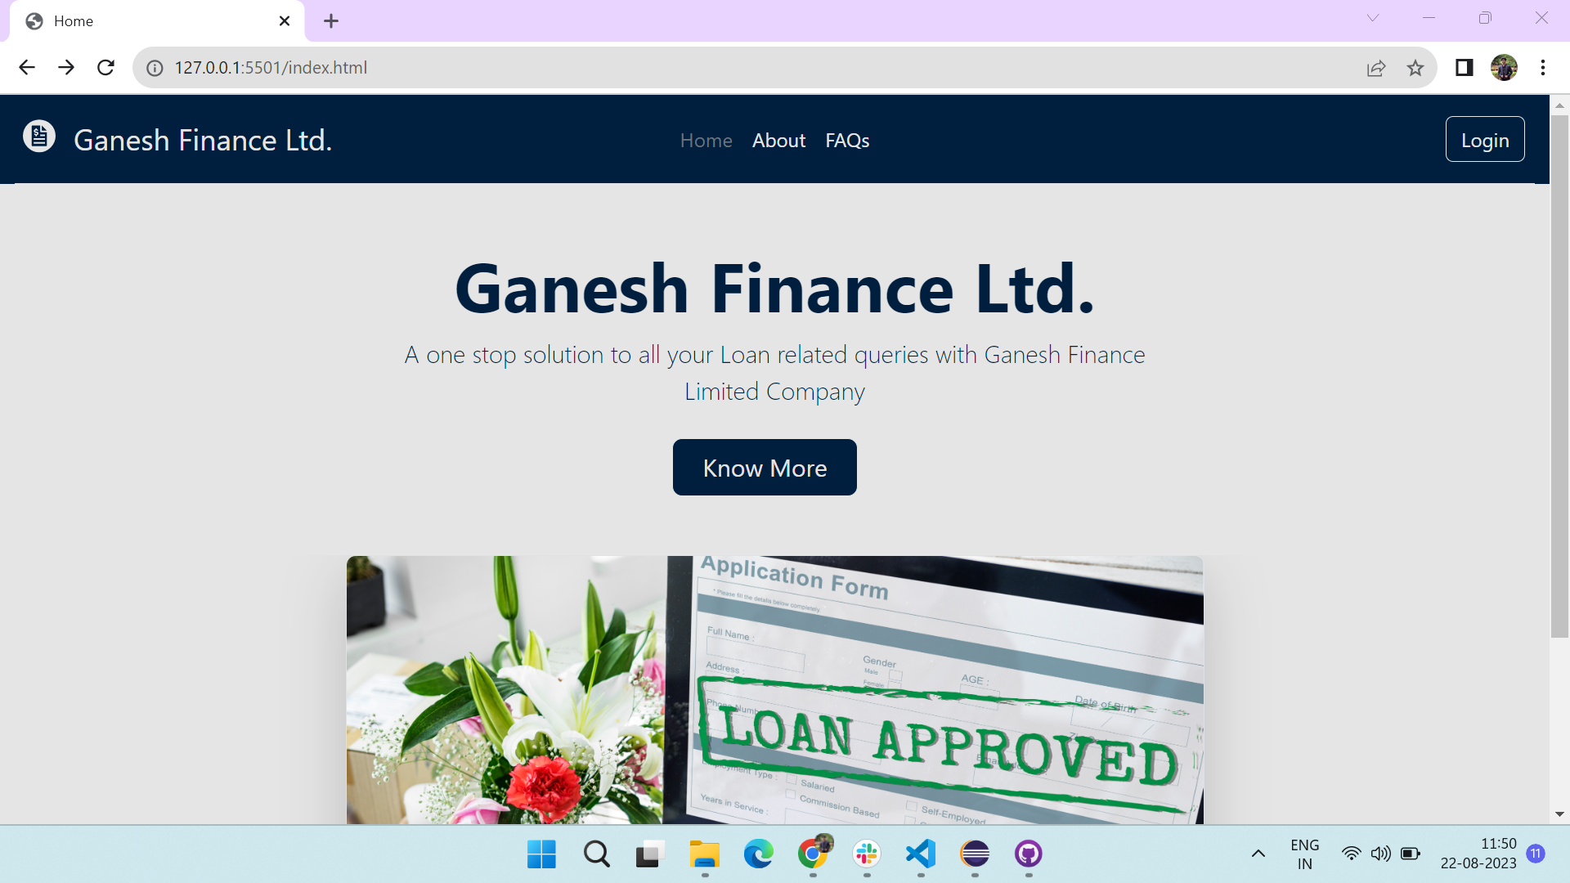
Application Landing Page

Slide 10
Demo
LIVE DEMO

Slide 11
Questions?

Slide 12
Thank You

